Slide 1
I am functional and oO can Too!
Will Pleasant-Ryan

Slide 2
Functional Programming is great
Functions!
first-class citizens
closures
partial application / currying
Composition
Immutability!
No side effects
reduce surprises / hidden complexity
easier to analyze & test
Notes:
Specific example where immutability would have helped an AO project

Slide 3
But sometimes Functional programming isn’t the right choice
Explicit customer requirement
Customer ecosystem
Eventual maintainers
Existing libraries / ecosystem in problem domain

Slide 4
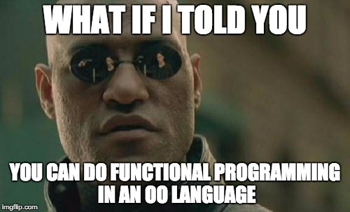

Slide 5
Functional OO
We’ll Examine techniques for writing more functional code in:
Ruby
C#
Javascript

Slide 6
Functions As First-Class Citizens
Ruby Uses Methods / SIGNALS, Not Functions
A Proc is about the closest Ruby has to a function
You might have seen arr.map(&:object_method), but you can use it on static methods
Notes:
A Proc is the closest thing ruby has to a function
You might know about &:mul2, you can apply to_proc to a method object

Slide 7
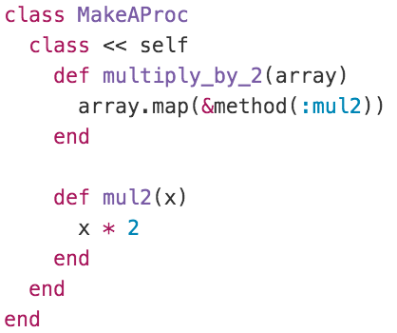
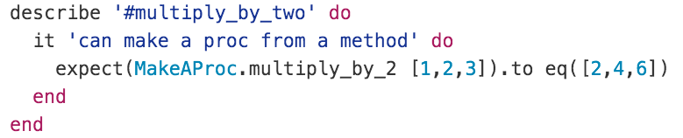
Functions As First-Class Citizens

Slide 8
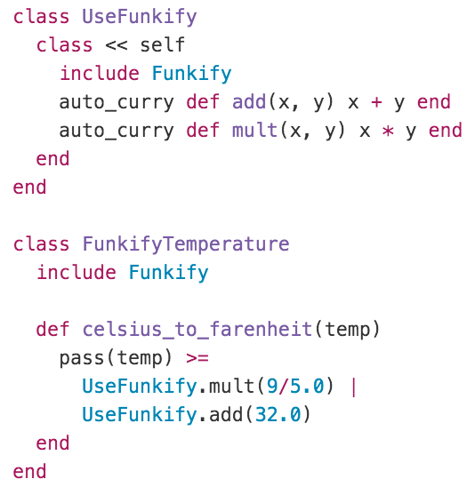
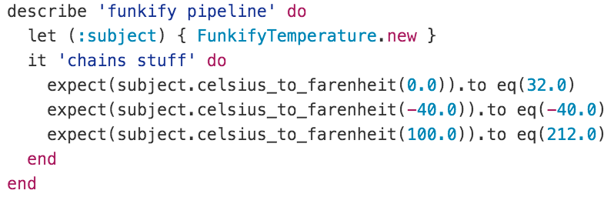
Partial Application / CURRYING / Function Composition
Notes:
Illegible to call func(func(func(x))), ugly to assign each step
Backward composition is more legible

Slide 9
Functions As First-Class Citizens
Static *MOSTLY* IMPLIES PURE
Use delegates
or Func<X,Y,Z> (which is a delegate)

Slide 10
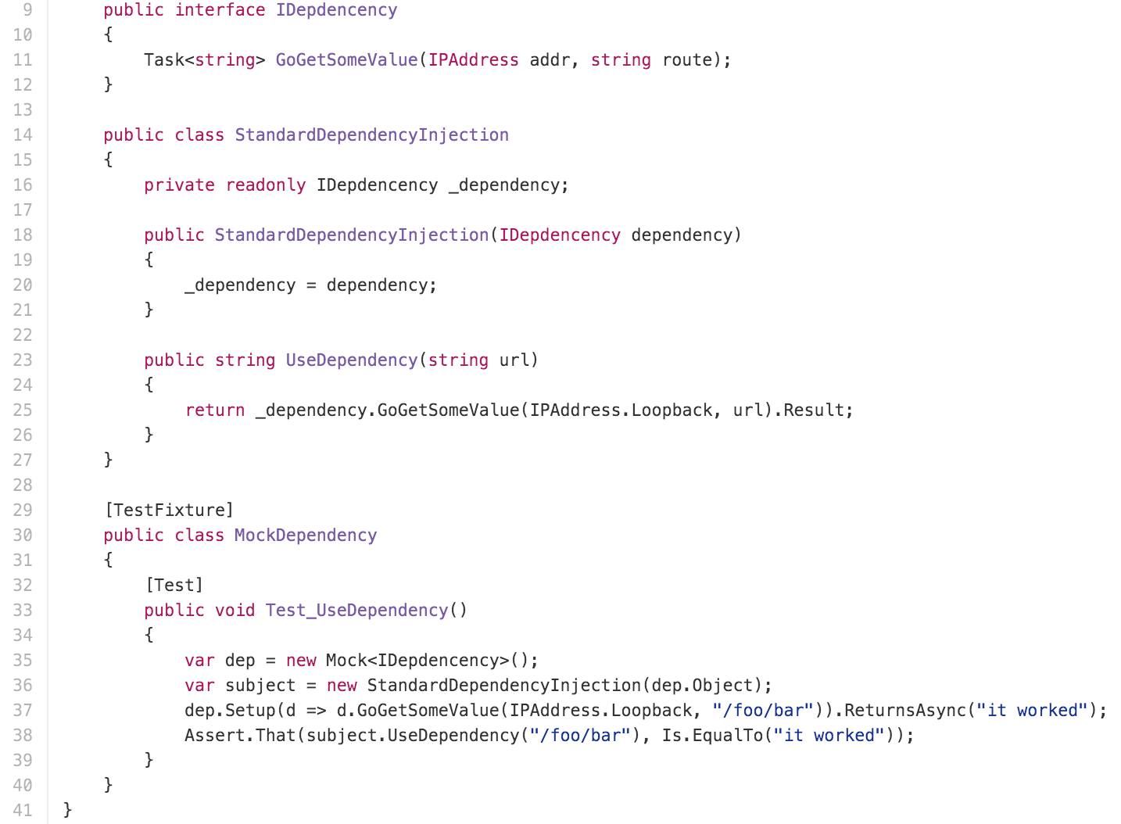
Partial Application / CURRYING
Notes:
You could use this structure to build up an implementation of Pythag that has Add, Mult, Sqrt, etc., but that is a TON of boilerplate when you just want a few functions. Let’s try it with delegates:

Slide 11
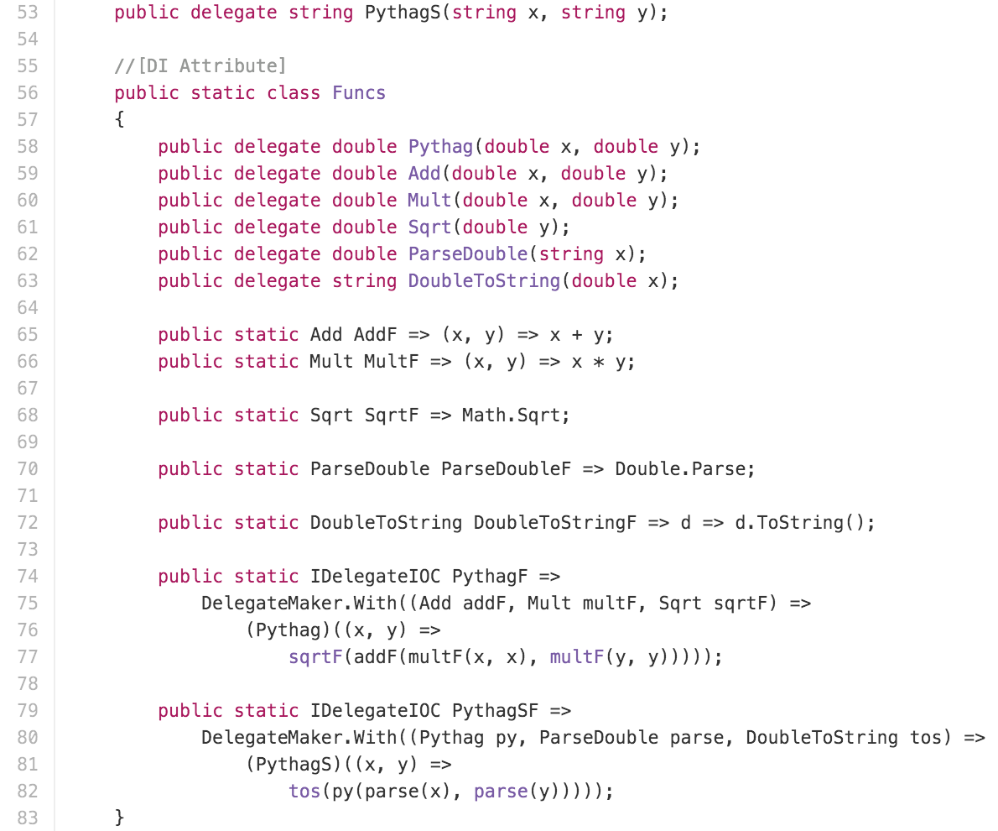
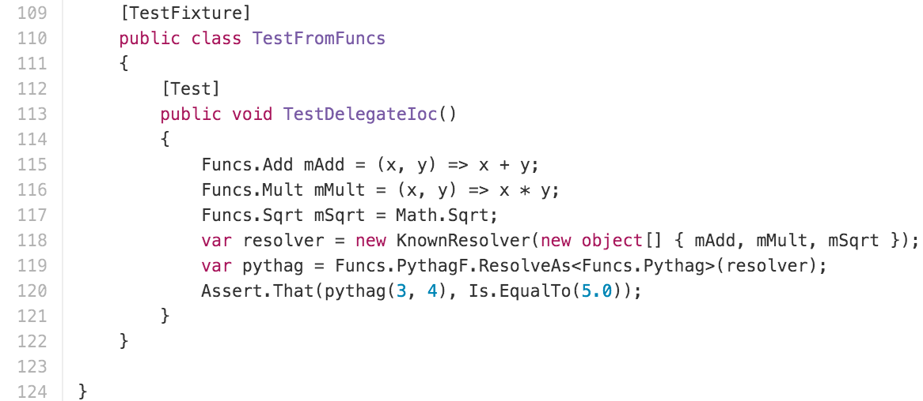
Partial Application / CURRYING

Slide 12
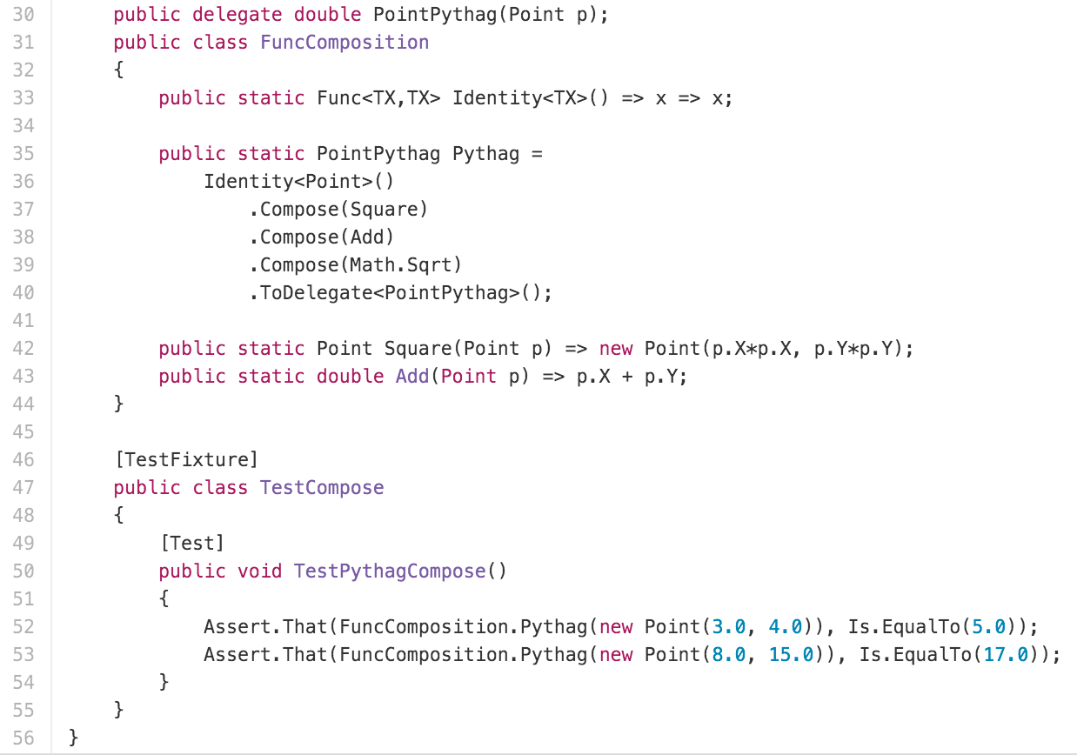
FUNCTION COMPOSITION

Slide 13
Functions As First-Class Citizens
Built in to javascript

Slide 14
Partial Application / CURRYING / Function Composition
Use bind()
Compose is (mostly) straightforward
Dependency injection systems (e.g. Ember service registry)

Slide 15
Questions?

Slide 16
IMMUTABILITY
RubY has Gem Hamsterdam
Works like Ruby’s Struct
Built on Hamster library or Clojure’s IMMUtable structures

Slide 17
IMMUTABILITY
C# is statically typed and so a library can’t really introduce usable immutability
However you can create immutable structures “LONGHAND”
Adding equality is a real pain

Slide 18
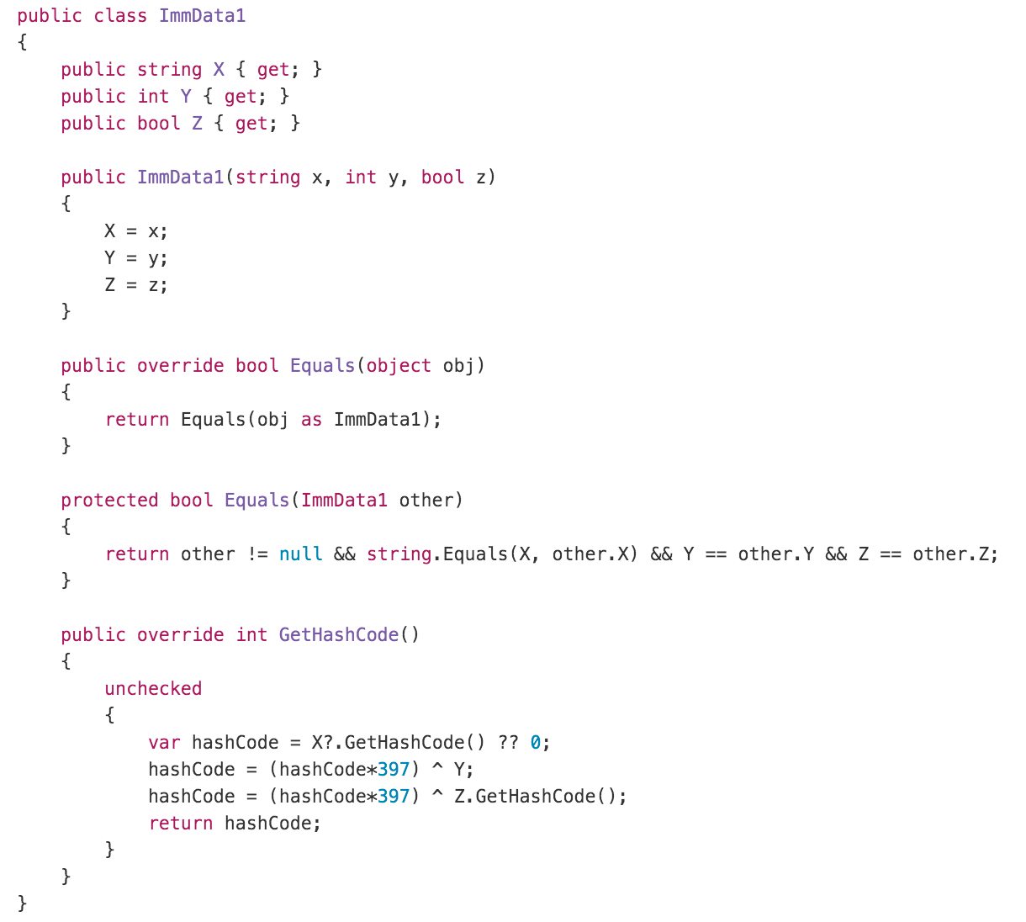
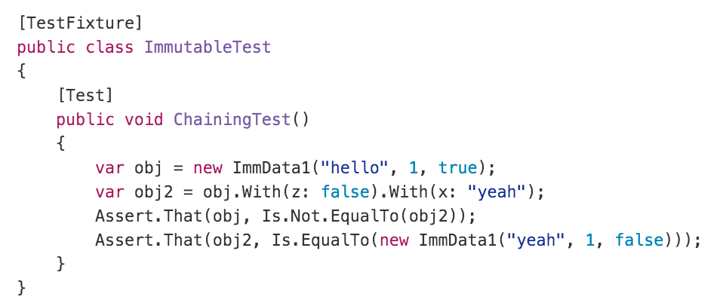
IMMUTABILITY

Slide 19
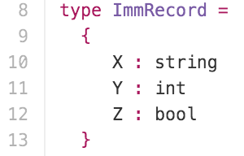
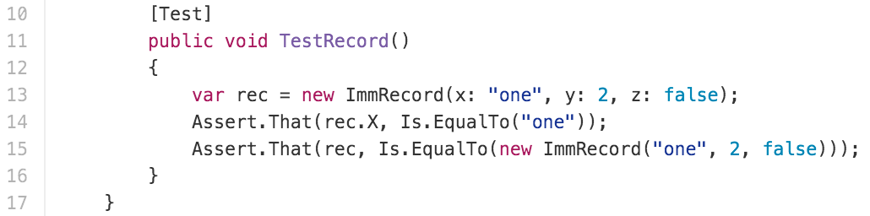
IMMUTABILITY
Notes:
Use same field names

Slide 20
IMMUTABILITY
An interesting technique - Mock as if immutable
Wrap mutable libraries “As if immutable”
Instead of void Func(Foo)
Use Foo Func(Foo) and return the mutated input
Or create a thin wrapper
oWrap<Foo> Func<Foo>(Wrap<Foo> wf) { wf.Foo.Mutate(); return new Wrap(wf.Foo); }
Treated mocked functions as immutable

Slide 21
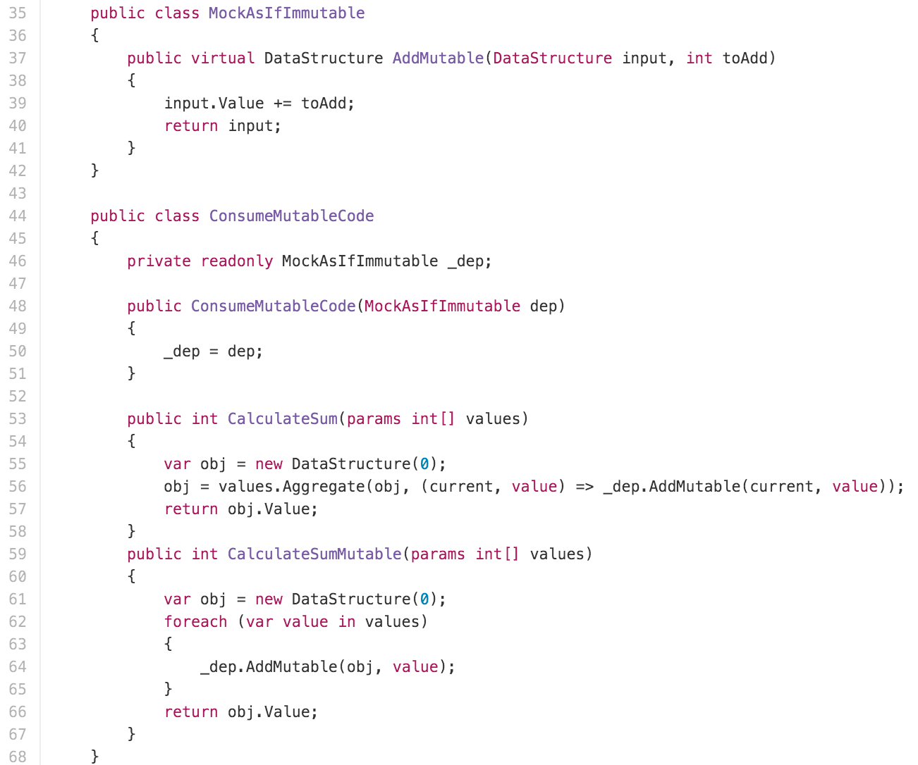
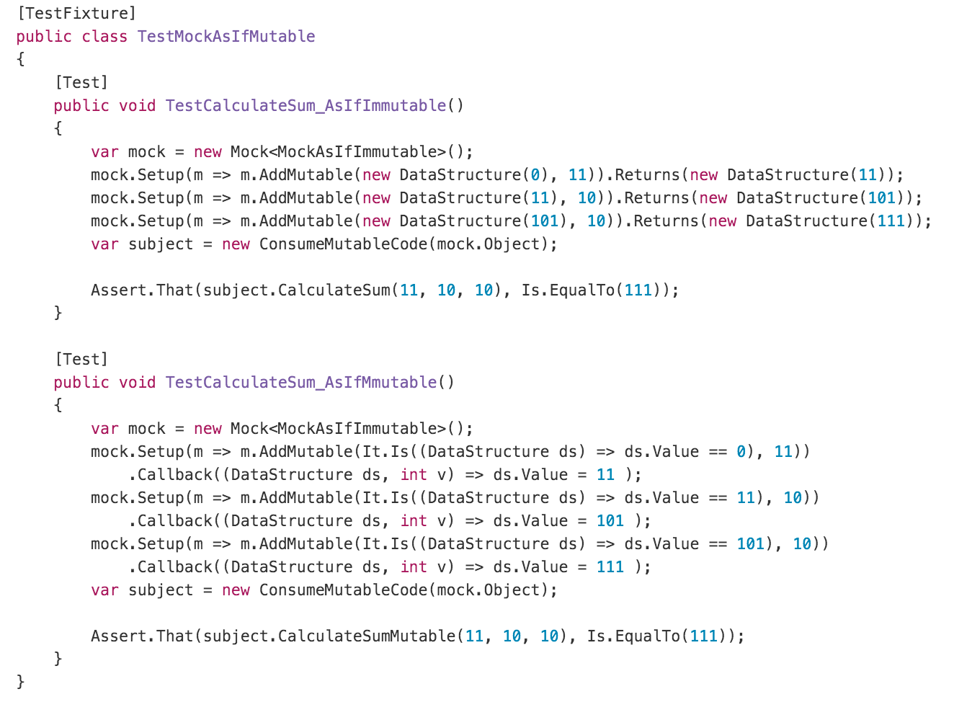
IMMUTABILITY

Slide 22
IMMUTABILITY
Immutable library
Freeze()

Slide 23
Questions?, Part 2

Slide 24

Go forth and be functional
Will Pleasant-RYan
will.ryan@atomicobject.com
@KreliAnodos
https://github.com/willryan/functional-oo

Slide 25
Functional Programming is great
But Wait there’s more!
Algebraic data types – expressively constrain valid states
Monads – control data flow
Homoiconicity – code-as-data, METAPROGRAMMING

Slide 26

Choose wisely
Algebraic Data Types
Monads
Homoiconicity

Slide 27
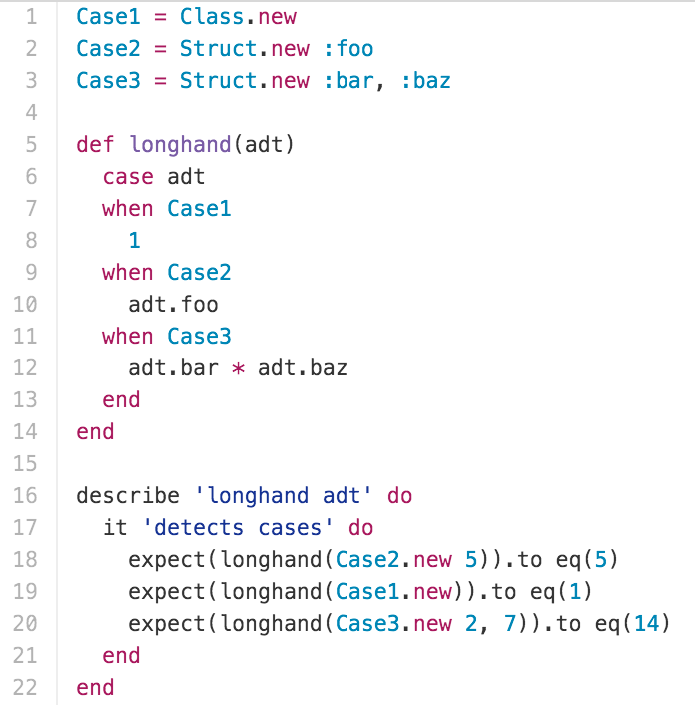
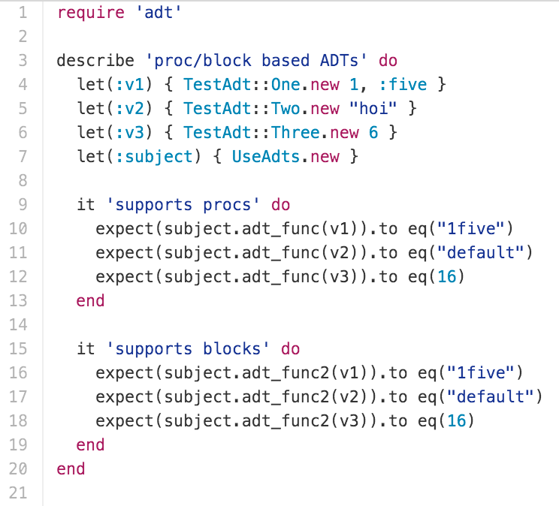
Algebraic Data types

Slide 28
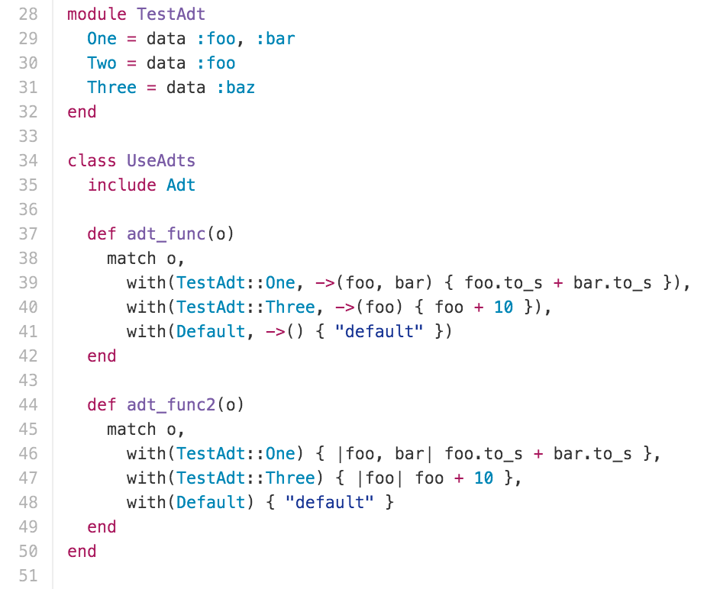
Algebraic Data types

Slide 29
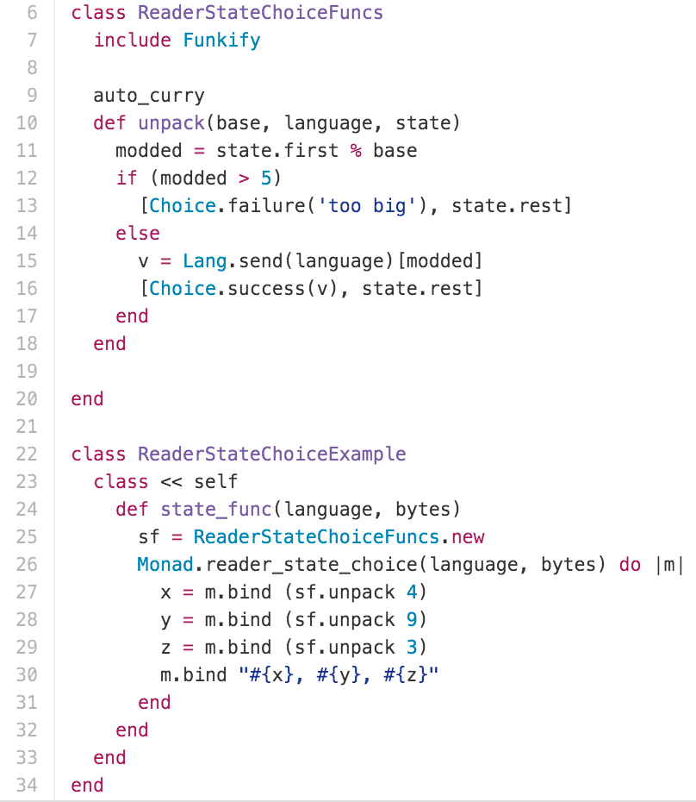
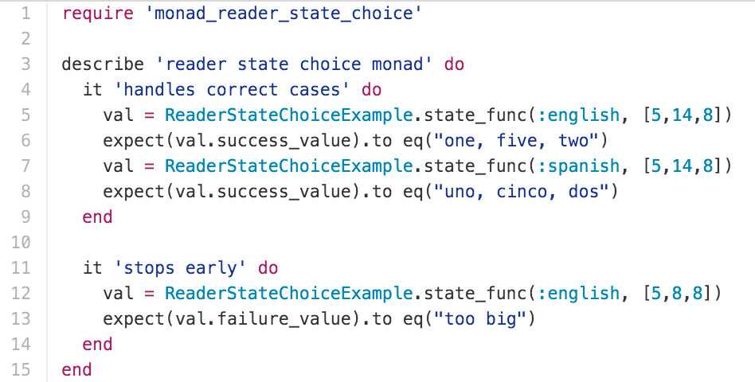
MONADS

Slide 30
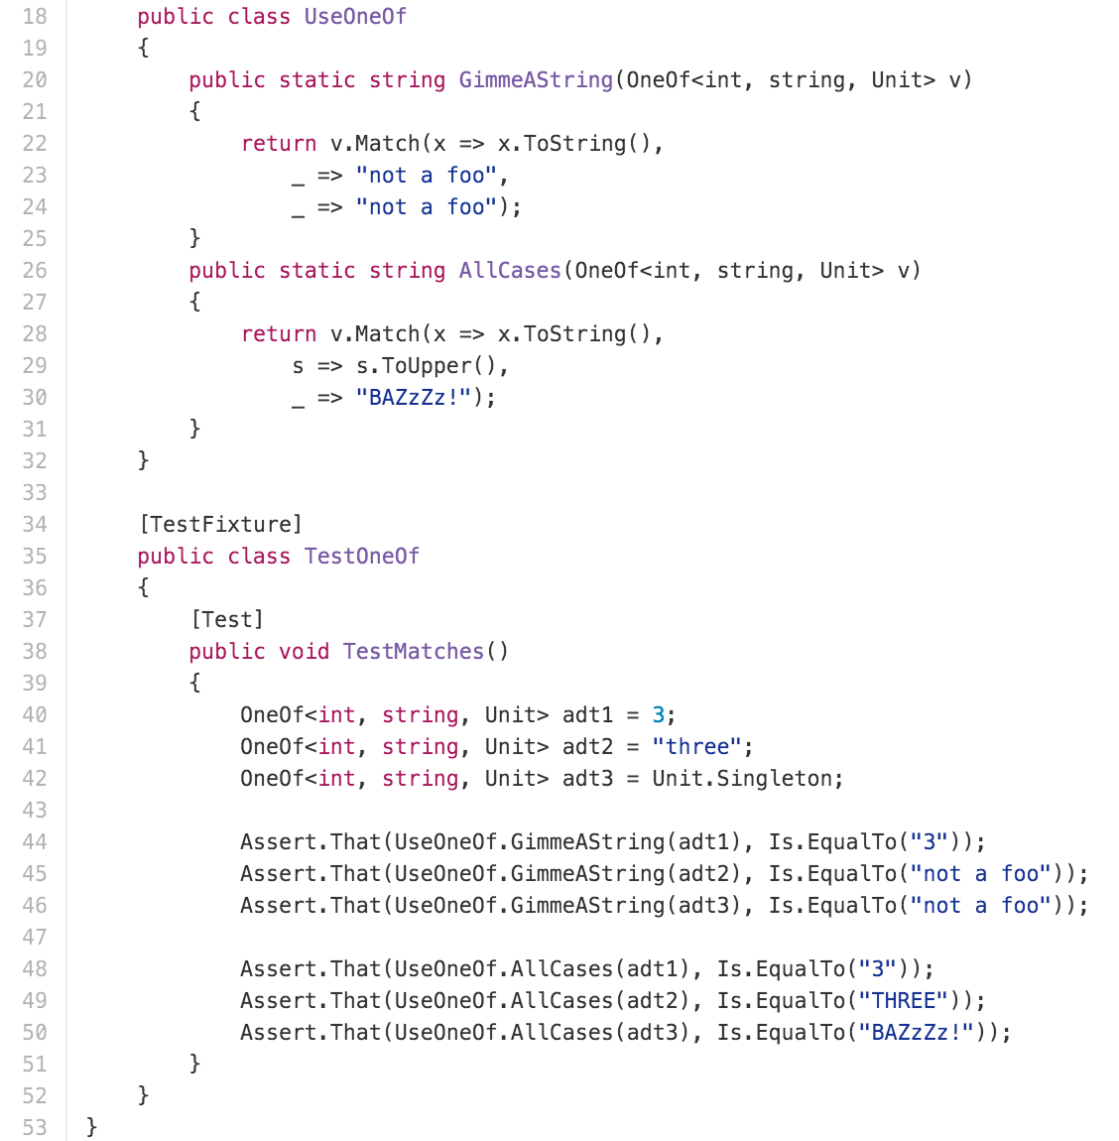
Algebraic Data Types

Slide 31
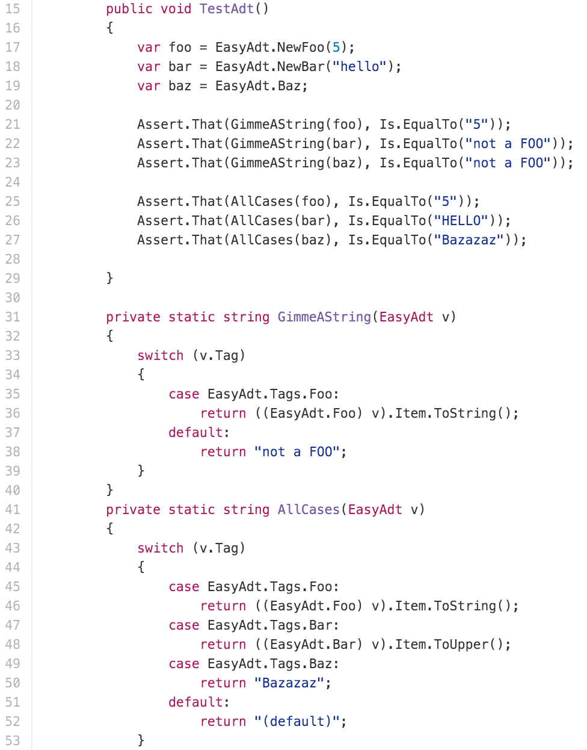
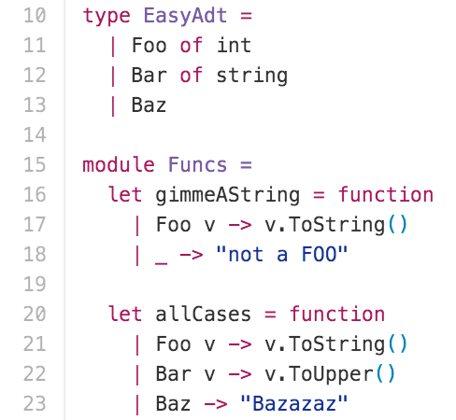
Algebraic Data Types

Slide 32
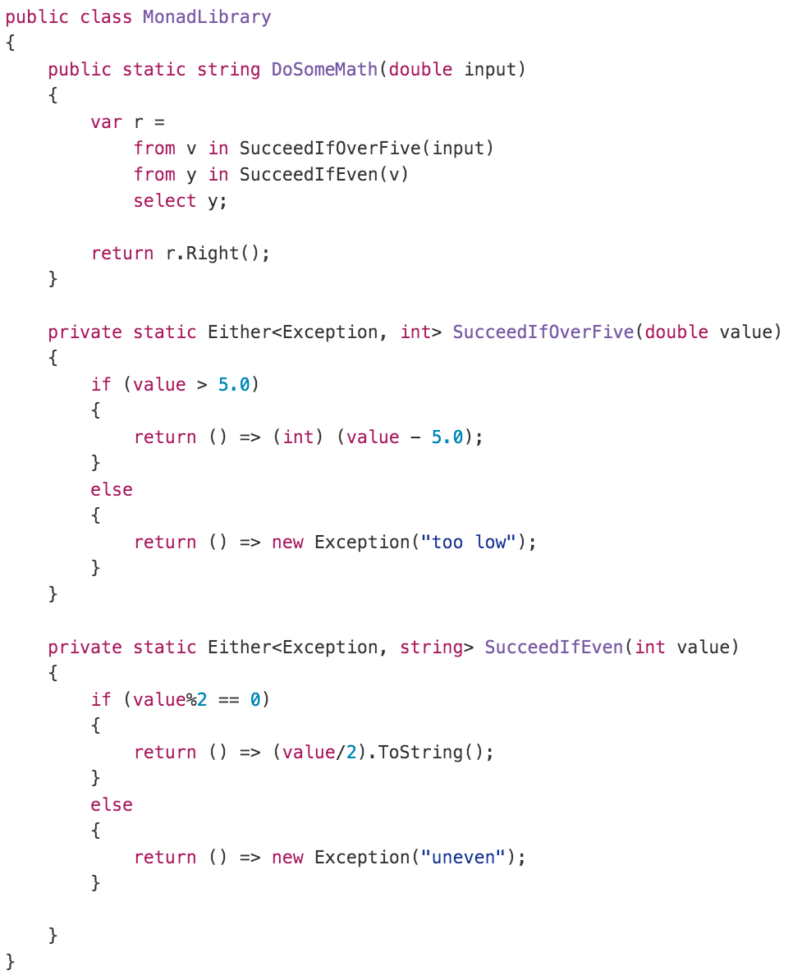
MONADS

Slide 33
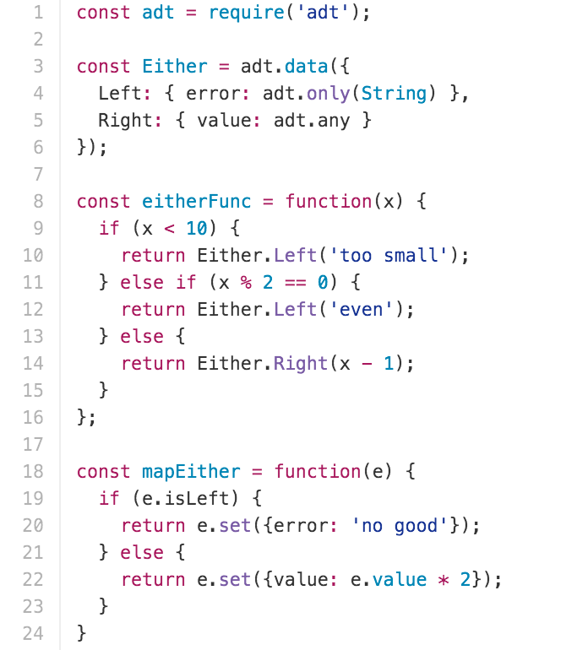
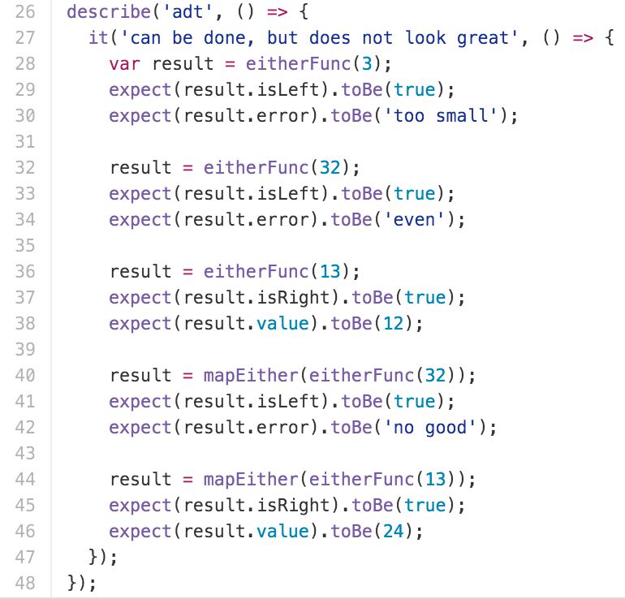
Algebraic Data Types

Slide 34
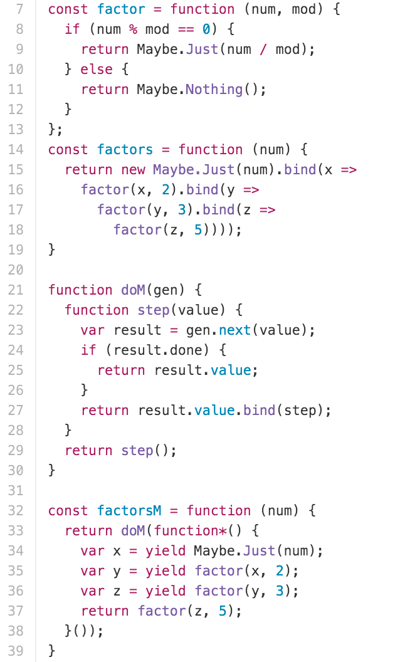
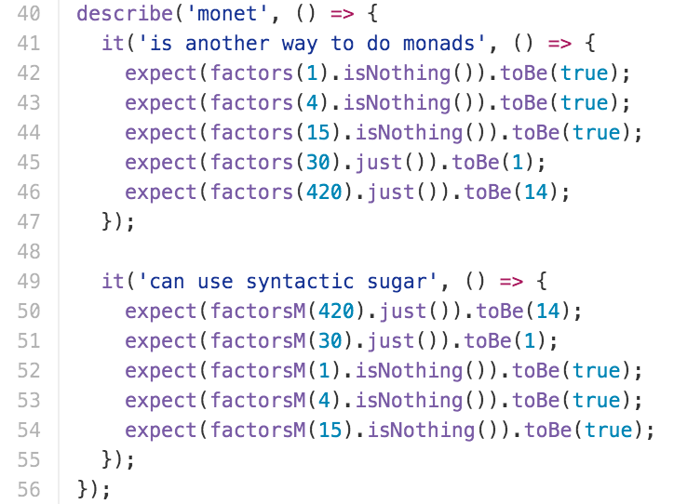
MONADS

Slide 35
METAPROGRAMMING
Domain specific languages
Instruction “builders” (e.g. Ember Acceptance tests)
AST
Expression<> OR il construction in C#
RubyVM::InstructionSequence.compile in Ruby

